Slide 1
An Overview of Pipelining
Dr. Rajib Ranjan Maiti
CSIS, BITS-Pilani, Hyderabad

Slide 2
Pipelining
Multiple instructions are overlapped in execution
Anyone who has done a lot of laundry has intuitively used pipelining
The nonpipelined approach to laundry would be as follows:
1. Place one dirty load of clothes in the washer
2. When the washer is finished, place the wet load in the dryer
3. When the dryer is finished, place the dry load on a table and fold
4. When folding is finished, ask your roommate to put the clothes away
When your roommate is done, start over with the next dirty load

Slide 3
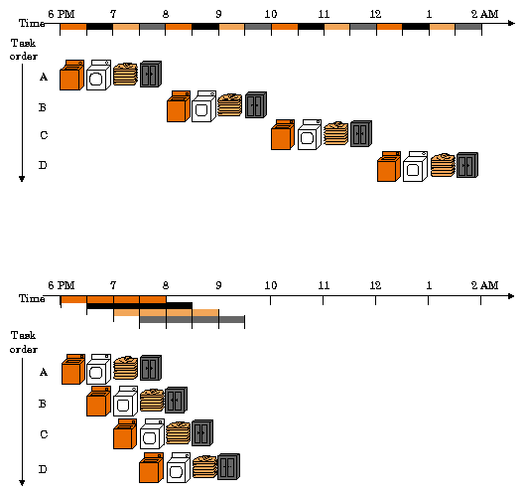
FIGURE 4.25 The laundry analogy for pipelining. Ann, Brian, Cathy, and Don each have dirty clothes to be washed, dried, folded, and put away. Th e washer, dryer, “folder,” and “storer” each take 30 minutes for their task. Sequential laundry takes 8 hours for 4 loads of wash, while pipelined laundry takes just 3.5 hours. We show the pipeline stage of diff erent loads over time by showing copies of the four resources on this two-dimensional time line, but we really have just one of each resource.

Slide 4
Pipeline possibility in MIPS
MIPS instructions classically take five steps:
1. Fetch instruction from memory.
2. Read registers while decoding the instruction. Th e regular format of MIPS instructions allows reading and decoding to occur simultaneously.
3. Execute the operation or calculate an address.
4. Access an operand in data memory.
5. Write the result into a register.

Slide 5
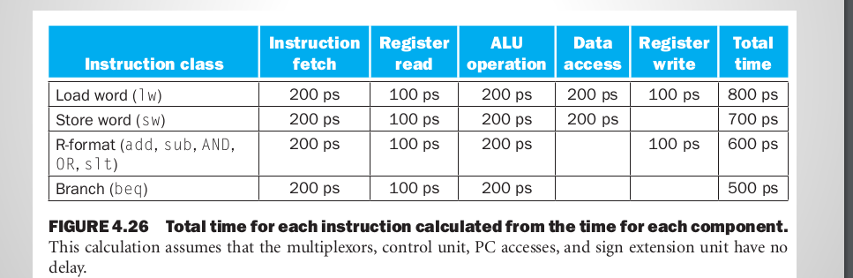
Pipelining speeds up instruction execution
we limit our attention to eight instructions:
load word (lw), store word (sw), add (add), subtract (sub), AND (and), OR (or), set less than (slt), and branch on equal (beq)
The operation times for the major functional units are
200 ps for memory access,
200 ps for ALU operation, and
100 ps for register file read or write
In the single-cycle model, every instruction takes exactly one clock cycle, so the clock cycle must be stretched to accommodate the slowest instruction
it is lw—so the time required for every instruction is 800 ps

Slide 6
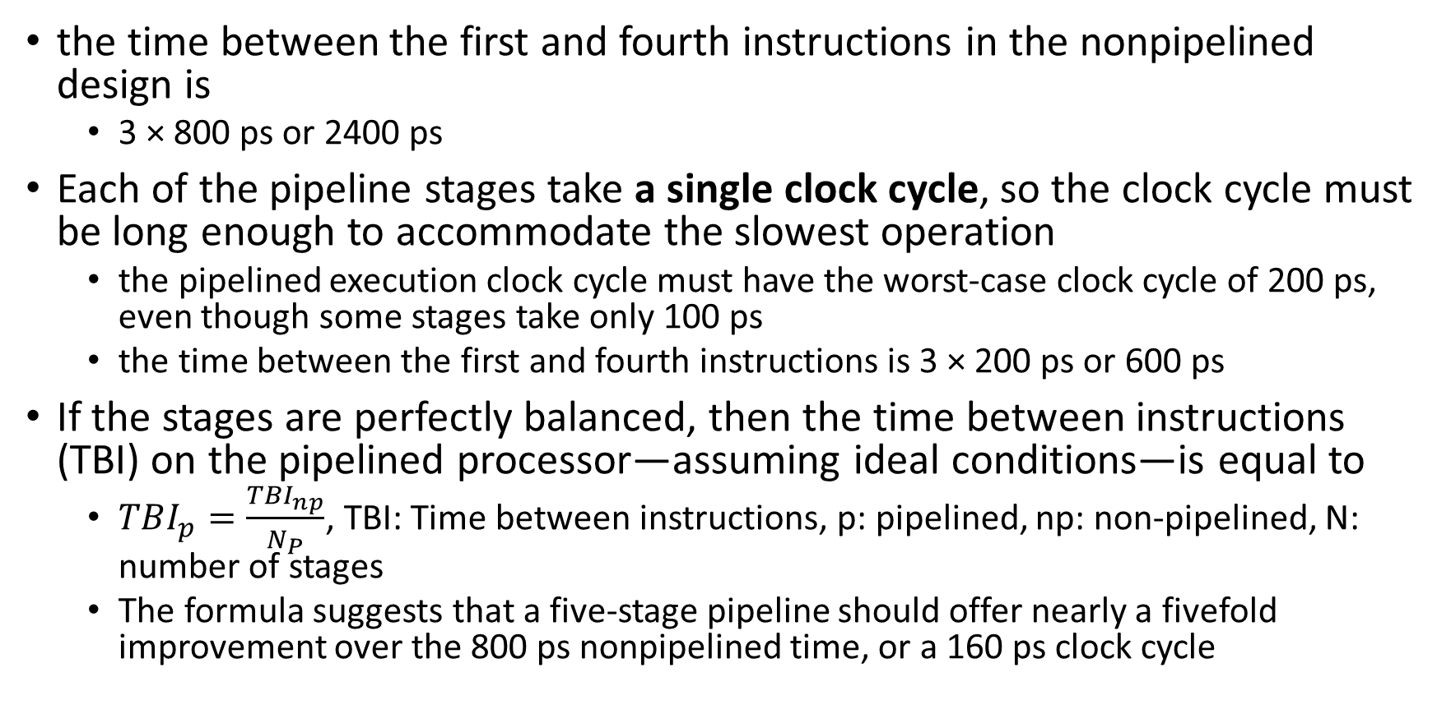
pipelining speeds up instruction execution
the time between the first and fourth instructions in the nonpipelined design is
3 × 800 ps or 2400 ps
Each of the pipeline stages take a single clock cycle, so the clock cycle must be long enough to accommodate the slowest operation
the pipelined execution clock cycle must have the worst-case clock cycle of 200 ps, even though some stages take only 100 ps
the time between the first and fourth instructions is 3 × 200 ps or 600 ps
If the stages are perfectly balanced, then the time between instructions (TBI) on the pipelined processor—assuming ideal conditions—is equal to
$TBI_{p}=\frac{TBI_{np}}{N_{P}}$, TBI: Time between instructions, p: pipelined, np: non-pipelined, N: number of stages
The formula suggests that a five-stage pipeline should offer nearly a fivefold improvement over the 800 ps nonpipelined time, or a 160 ps clock cycle

Slide 7
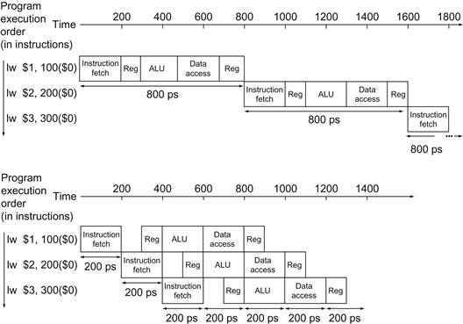
Single Cycle vs. Pipeline

Slide 8
Overhead in pipelining
pipelining involves some overhead,
the time per instruction in the pipelined processor will exceed the minimum possible, and
speed-up will be less than the number of pipeline stages
Pipelining improves performance by increasing instruction throughput,
as opposed to decreasing the execution time of an individual instruction,
but instruction throughput is the important metric because real programs execute billions of instructions.

Slide 9
Designing Instruction Sets for Pipelining
First, all MIPS instructions are the same length.
This restriction makes it much easier to fetch instructions in the first pipeline stage and to decode them in the second stage.
In an instruction set like the x86, where instructions vary from 1 byte to 15 bytes, pipelining is considerably more challenging.
Second, MIPS has only a few instruction formats, with the source register fields being located in the same place in each instruction
This symmetry means that the second stage can begin reading the register file at the same time that the hardware is determining what type of instruction was fetched.
If MIPS instruction formats were not symmetric, we would need to split stage 2, resulting in six pipeline stages.
Third, memory operands only appear in loads or stores in MIPS.
This restriction means we can use the execute stage to calculate the memory address and then access memory in the following stage.
If we could operate on the operands in memory, as in the x86, stages 3 and 4 would expand to an address stage, memory stage, and then execute stage.
Fourth, operands must be aligned in memory.
Hence, we need not worry about a single data transfer instruction requiring two data memory accesses; the requested data can be transferred between processor and memory in a single pipeline stage.

Slide 10
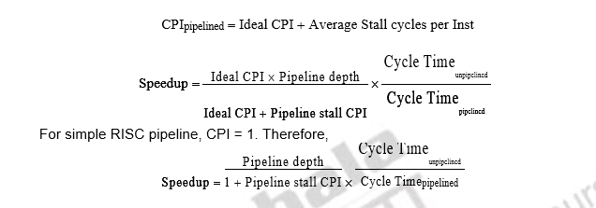
Performance Metrics

Slide 11
Pipeline Hazards

Slide 12
Pipeline Hazards
the next instruction cannot execute in the following clock cycle
three different types
structural hazard: hardware cannot support the combination of instructions that we want to execute in the same clock cycle
Data hazards: one step must wait for another to complete
add $s0, $t0, $t1
sub $t2, $s0, $t3
control hazard: make a decision based on the results of one instruction while others are executing

Slide 13
structural hazard:
lw $8, 100($9)
add $10, $11, $12
add $10, $11, $12
add $10, $8, $12
two instructions in the pipeline require the same resource
Solution is at hardware level: splitting the RF access to two clock phases, write on first phase and read on second phase
WR
RD
IF | ID ($9) | Ex ($9) | Mem | WB ($8)
 | IF | ID ($11, $12) | Ex ($11, $12) | Mem | WB ($10)
 |  | IF | ID ($11, $12) | Ex ($8, $12) | Mem | WB ($10)
 |  |  | IF | ID ($8, $12) | Ex ($8, $12) | Mem | WB ($10)
Suppose, however, that we had a single memory instead of two memories

Slide 14
Data Hazards
An instruction depends on the result of prior instruction still in the pipeline
Add $s0, $t0, $t1
Sub $t2, $s0, Tt3

Slide 15
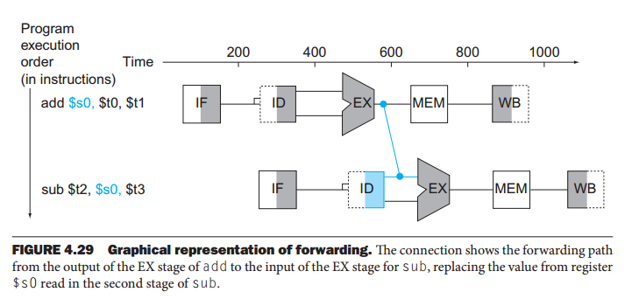
Data Hazards
An instruction depends on the result of prior instruction still in the pipeline
Add $s0, $t0, $t1
Sub $t2, $s0, Tt3

Slide 16
Data Hazards
Reordering Code to Avoid Pipeline Stalls
Find the hazards in the preceding code segment
Reorder the instructions to avoid any pipeline stalls.
assuming all variables are in memory and are addressable as off sets from $t0:
lw $t1, 0($t0)
lw $t2, 4($t0)
add $t3, $t1,$t2
sw $t3, 12($t0)
lw $t4, 8($t0)
add $t5, $t1,$t4
sw $t5, 16($t0)
Consider the following code segment in C:
a = b + e;
c = b + f;

Slide 17
Find the hazards in the preceding code segment
assuming all variables are in memory and are addressable as off sets from $t0:
lw $t1, 0($t0)
lw $t2, 4($t0)
add $t3, $t1,$t2
sw $t3, 12($t0)
lw $t4, 8($t0)
add $t5, $t1,$t4
sw $t5, 16($t0)

Slide 18
Data Hazards
Reordering Code to Avoid Pipeline Stalls
Reordering Code to Avoid Pipeline Stalls
Both add instructions have a hazard because of their respective dependence on the immediately preceding lw instruction.
Moving up the third lw instruction to become the third instruction eliminates both hazards:
lw $t1, 0($t0)
lw $t2, 4($t0)
lw $t4, 8($t0)
add $t3, $t1,$t2
sw $t3, 12($t0)
add $t5, $t1,$t4
sw $t5, 16($t0)
Advantage: On a pipelined processor with forwarding, the reordered sequence will complete in two fewer cycles than the original version
MIPS code :
lw $t1, 0($t0)
lw $t2, 4($t0)
add $t3, $t1,$t2
sw $t3, 12($t0)
lw $t4, 8($t0)
add $t5, $t1,$t4
sw $t5, 16($t0)

Slide 19
Data Hazards
3 kinds of data hazards:
Write After Read (WAR)
add r4, r1,
add r1, r3, r5
add R1, R2, R3
sub R2, R4, R1
or R1, R6, R3
Read After Write (RAW)
ADD R1, R2, R3
SUB R4, R1, R6
store R1, 0($t0)
load R4, 0($t0)
Read After Read (RAR)
add R1, R2, R3
sub R2, R4, R1
or R1, R6, R3
Write After Write (WAW)
add R1,R2,R3
sub R2,R4,R1
or R1,R6,R3
add r1, r2, r3
add r4, r1, r5
add r1, r3, r5
For MIPS integer pipeline, all data hazards can be checked during ID phase of pipeline

Slide 20
Data Hazard
Antidependence:
A dependence between two instructions . . .
. . . indicating a value written by the second . . .
. . . that the first instruction reads.
Write After Read (WAR)
add r1, r2, r3
sub r2, r4, r5
Name Dependency
Output Dependence:
A dependence between two instructions . . .
. . . indicating that both instructions write the same location . . .
. . . (register or memory address).
Write After Write (WAW)
add R1,R2,R3
sub R2,R4,R1
or R1,R6,R3

Slide 21
Control Hazards
Caused by delay between the fetching of instructions and decisions about changes in control flow
add $4, $5, $6
beq $1, $2, ELSE
or $7, $8, $9
ELSE: and $7, $8, $9

Slide 22
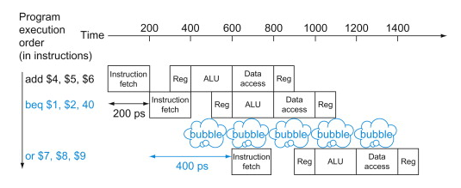
Control Hazards
One solutions to control hazards
Stall: certainly works, but it is slow
Performance of “Stall on Branch”
Assume all other instructions have a CPI of 1
branches are 17% of the instructions executed in SPECint2006
Since branches took one extra clock cycle for the stall,
we would see a CPI of 1.17 and hence a slowdown of 1.17 versus the ideal case

Slide 23
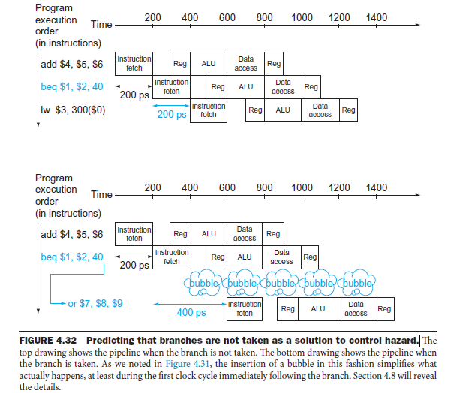
Control Hazards
When the guess is wrong,
the pipeline control must ensure that the instructions following the wrongly guessed branch have no effect
And, must restart the pipeline from the proper branch address

Slide 24
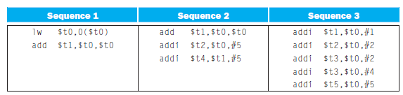
Pipeline Overview Summary
For each code sequence below,
state whether it must stall,
can avoid stalls using only forwarding, or
can execute without stalling or
forwarding
Pipelining increases the number of simultaneously executing instructions
and the rate at which instructions are started and completed. Pipelining
does not reduce the time it takes to complete an individual instruction,
also called the latency.
For example, the five-stage pipeline still takes 5 lock cycles for the instruction to complete. In the terms used in Chapter 1, pipelining improves instruction throughput rather than individual instruction execution time or latency.

Slide 25
Hazard Types:
Structural Hazard:
Needed resource currently busy.
Data Hazard:
Needed value not yet available or overwritten.
Control Hazard:
Needed instruction not yet available or wrong instruction executing.

Slide 26
